Slide 1
TEAM NO ## DSTR ROBOT
TEAM MEMBER ONE
TEAM MEMBER TWO
TEAM MEMBER THREE
TEAM MEMBER FOUR
Notes:
Hello, my name is SPEAKING NOTES

Slide 2
PROJECT OVERVIEW
Mechanical Sub- Assembly
Control Sub-Assembly
Conclusion
Notes:
project overview: we will go over the mechanical and control sub-assemblies.

Slide 3
MECHANICAL SUB-ASSEMBLY
DRILLING
MOTOR ASSEMBLY

Slide 4
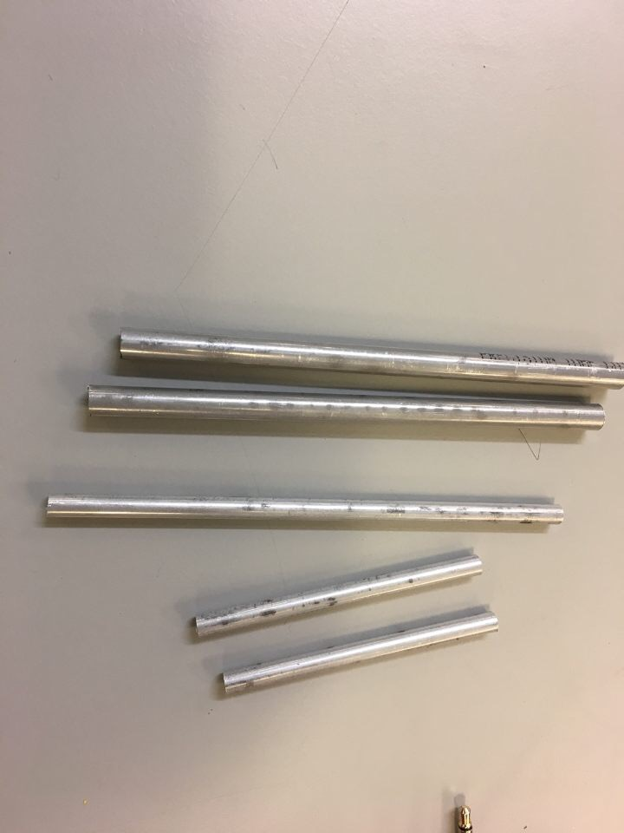
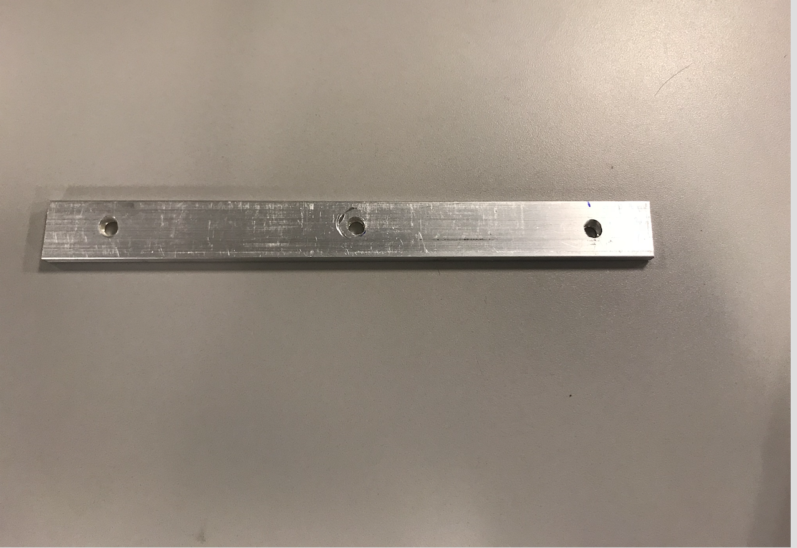
DRILLING
Figure 1

Slide 5
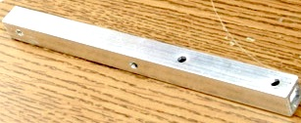
DRILLING
Figure 2

Slide 6
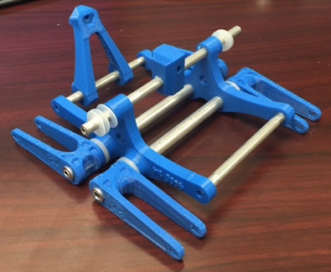
ASSEMBLING BODY
← PUT U-BRACES ON ALL OF THE LARGER AXLES
Figure 3

Slide 7
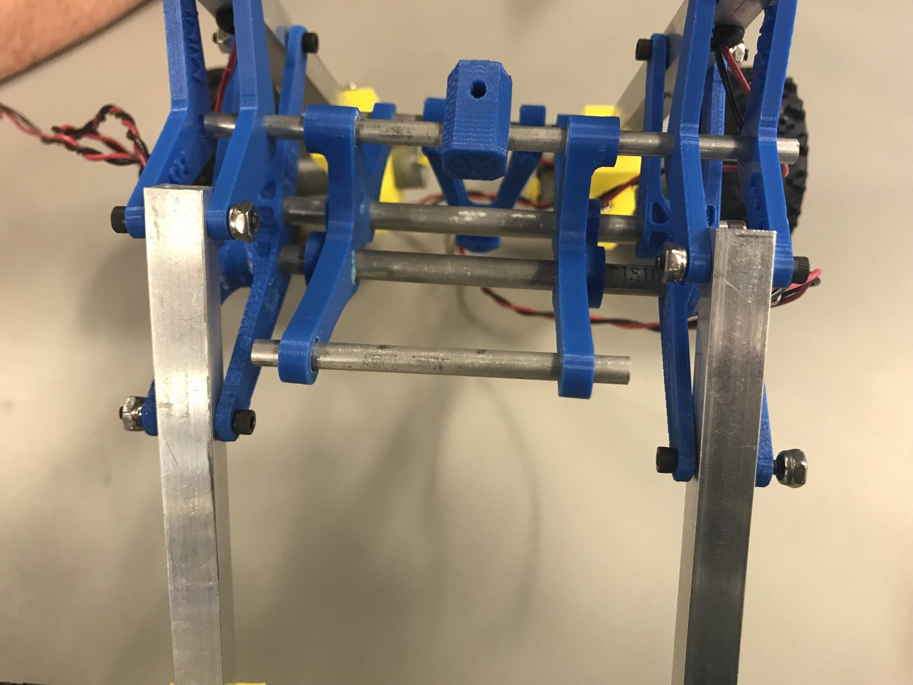
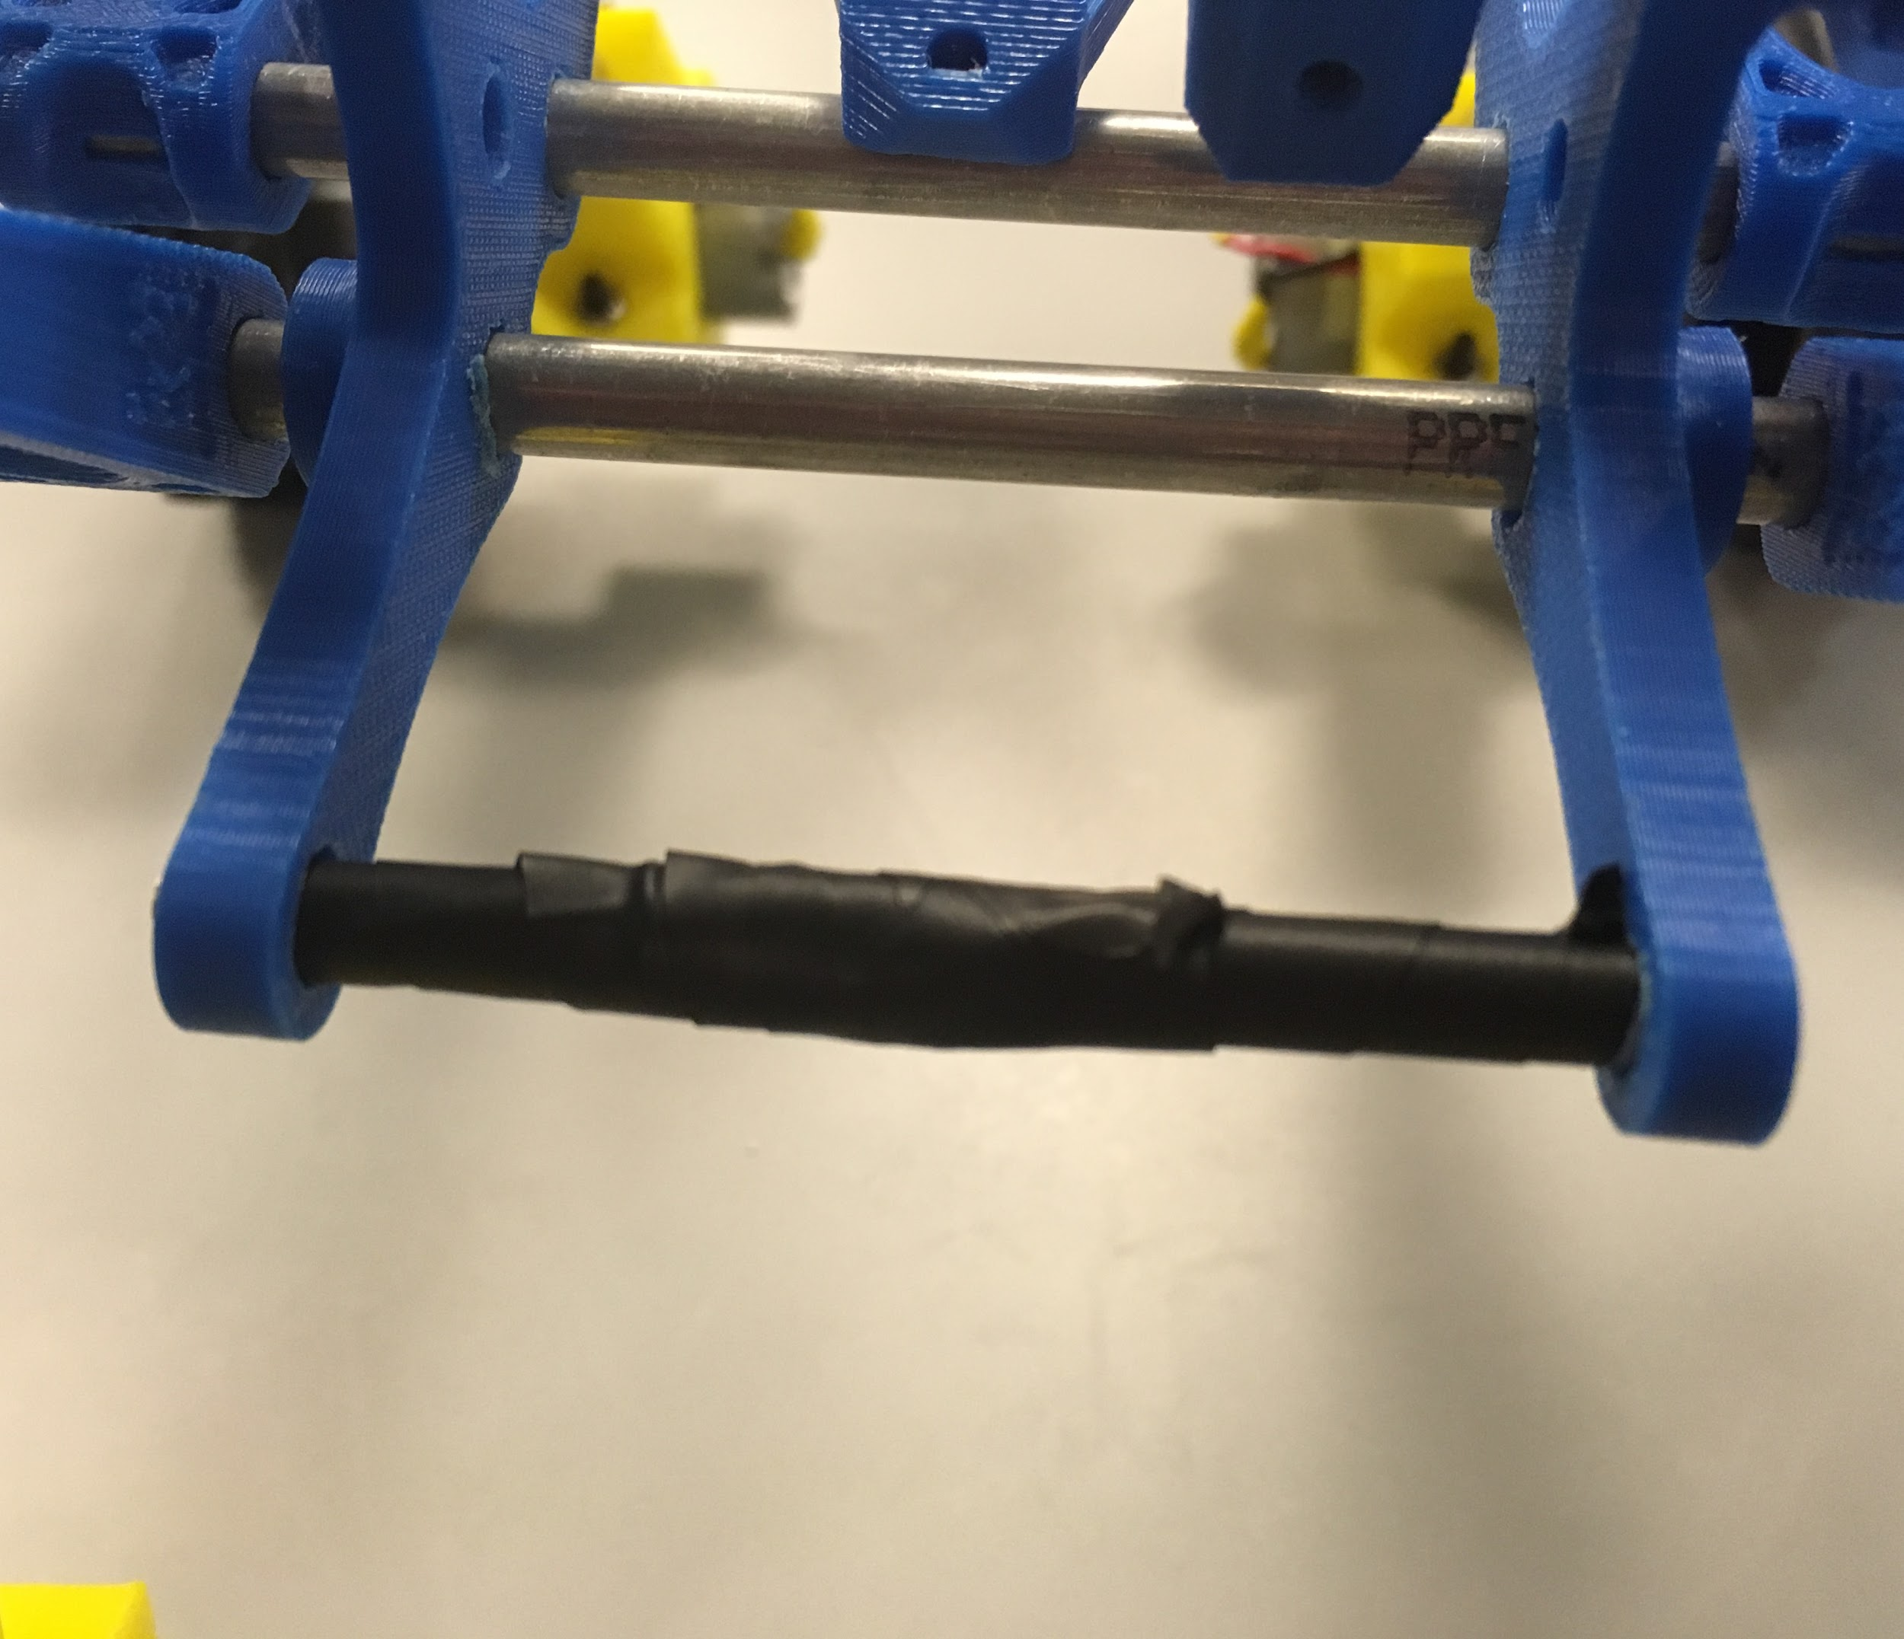
ASSEMBLING BODY
ADDING ELECTRICAL TAPE OPPOSITE WISHBONE
Figure 4

Slide 8
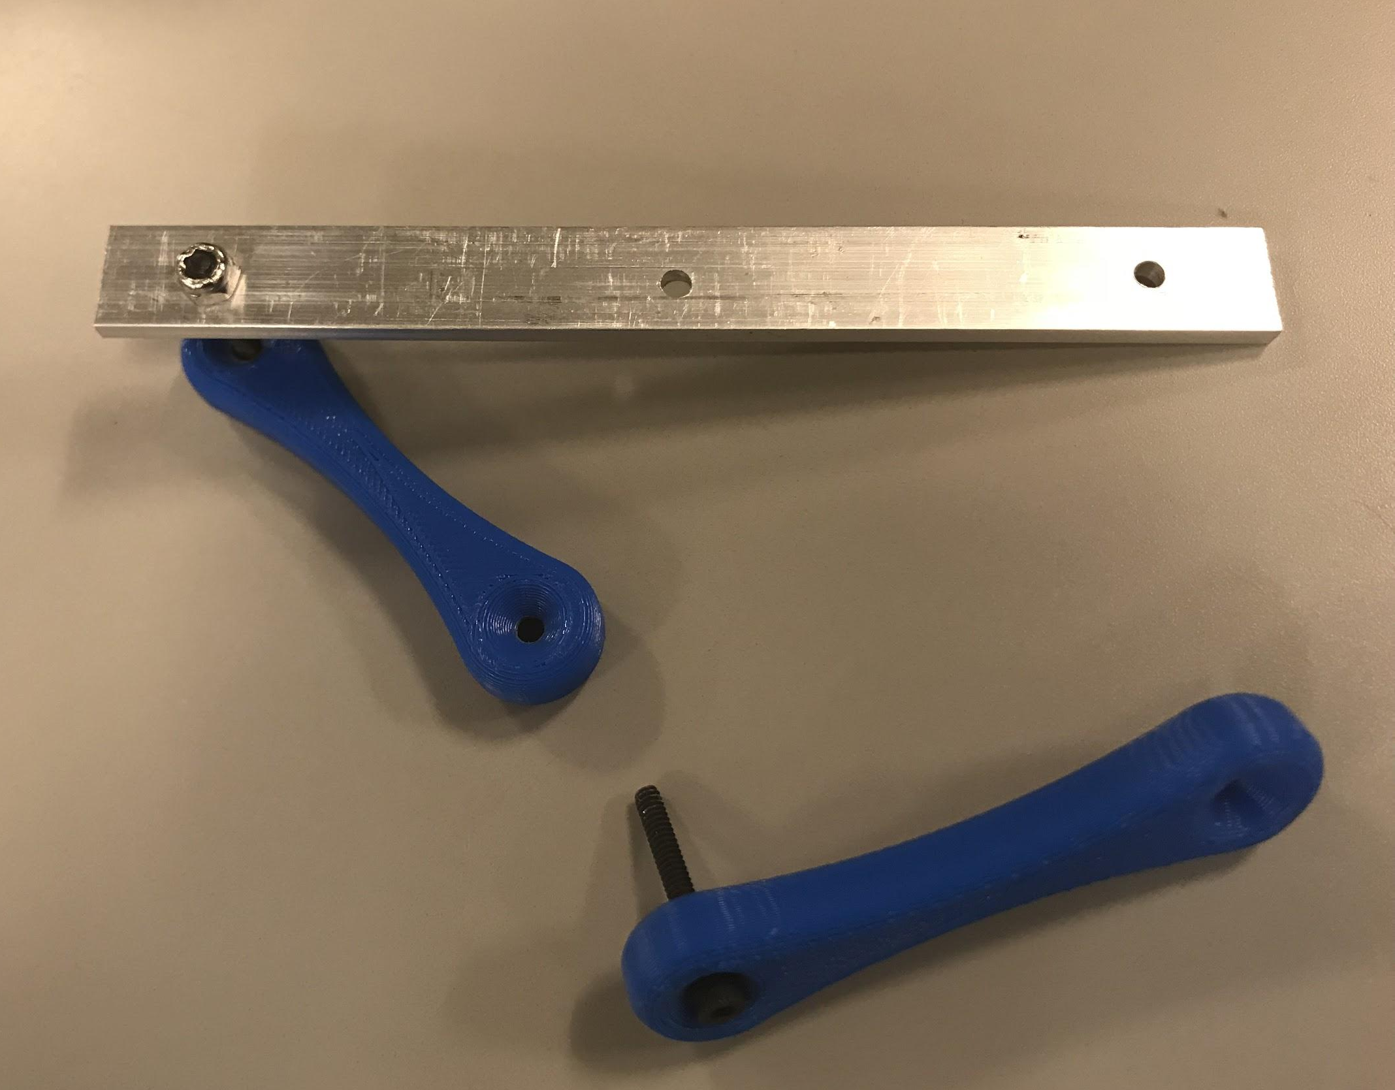
ASSEMBLING BODY
Figure 5

Slide 9
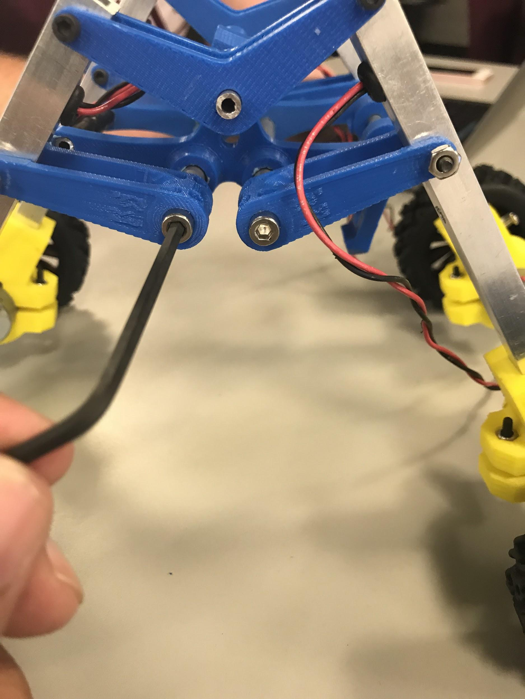
ATTACHING HEX HEAD BOLTS
← USING HEX HEAD BOLTS TO SECURE U-LINKS TO AXLE.
Figure 6

Slide 10
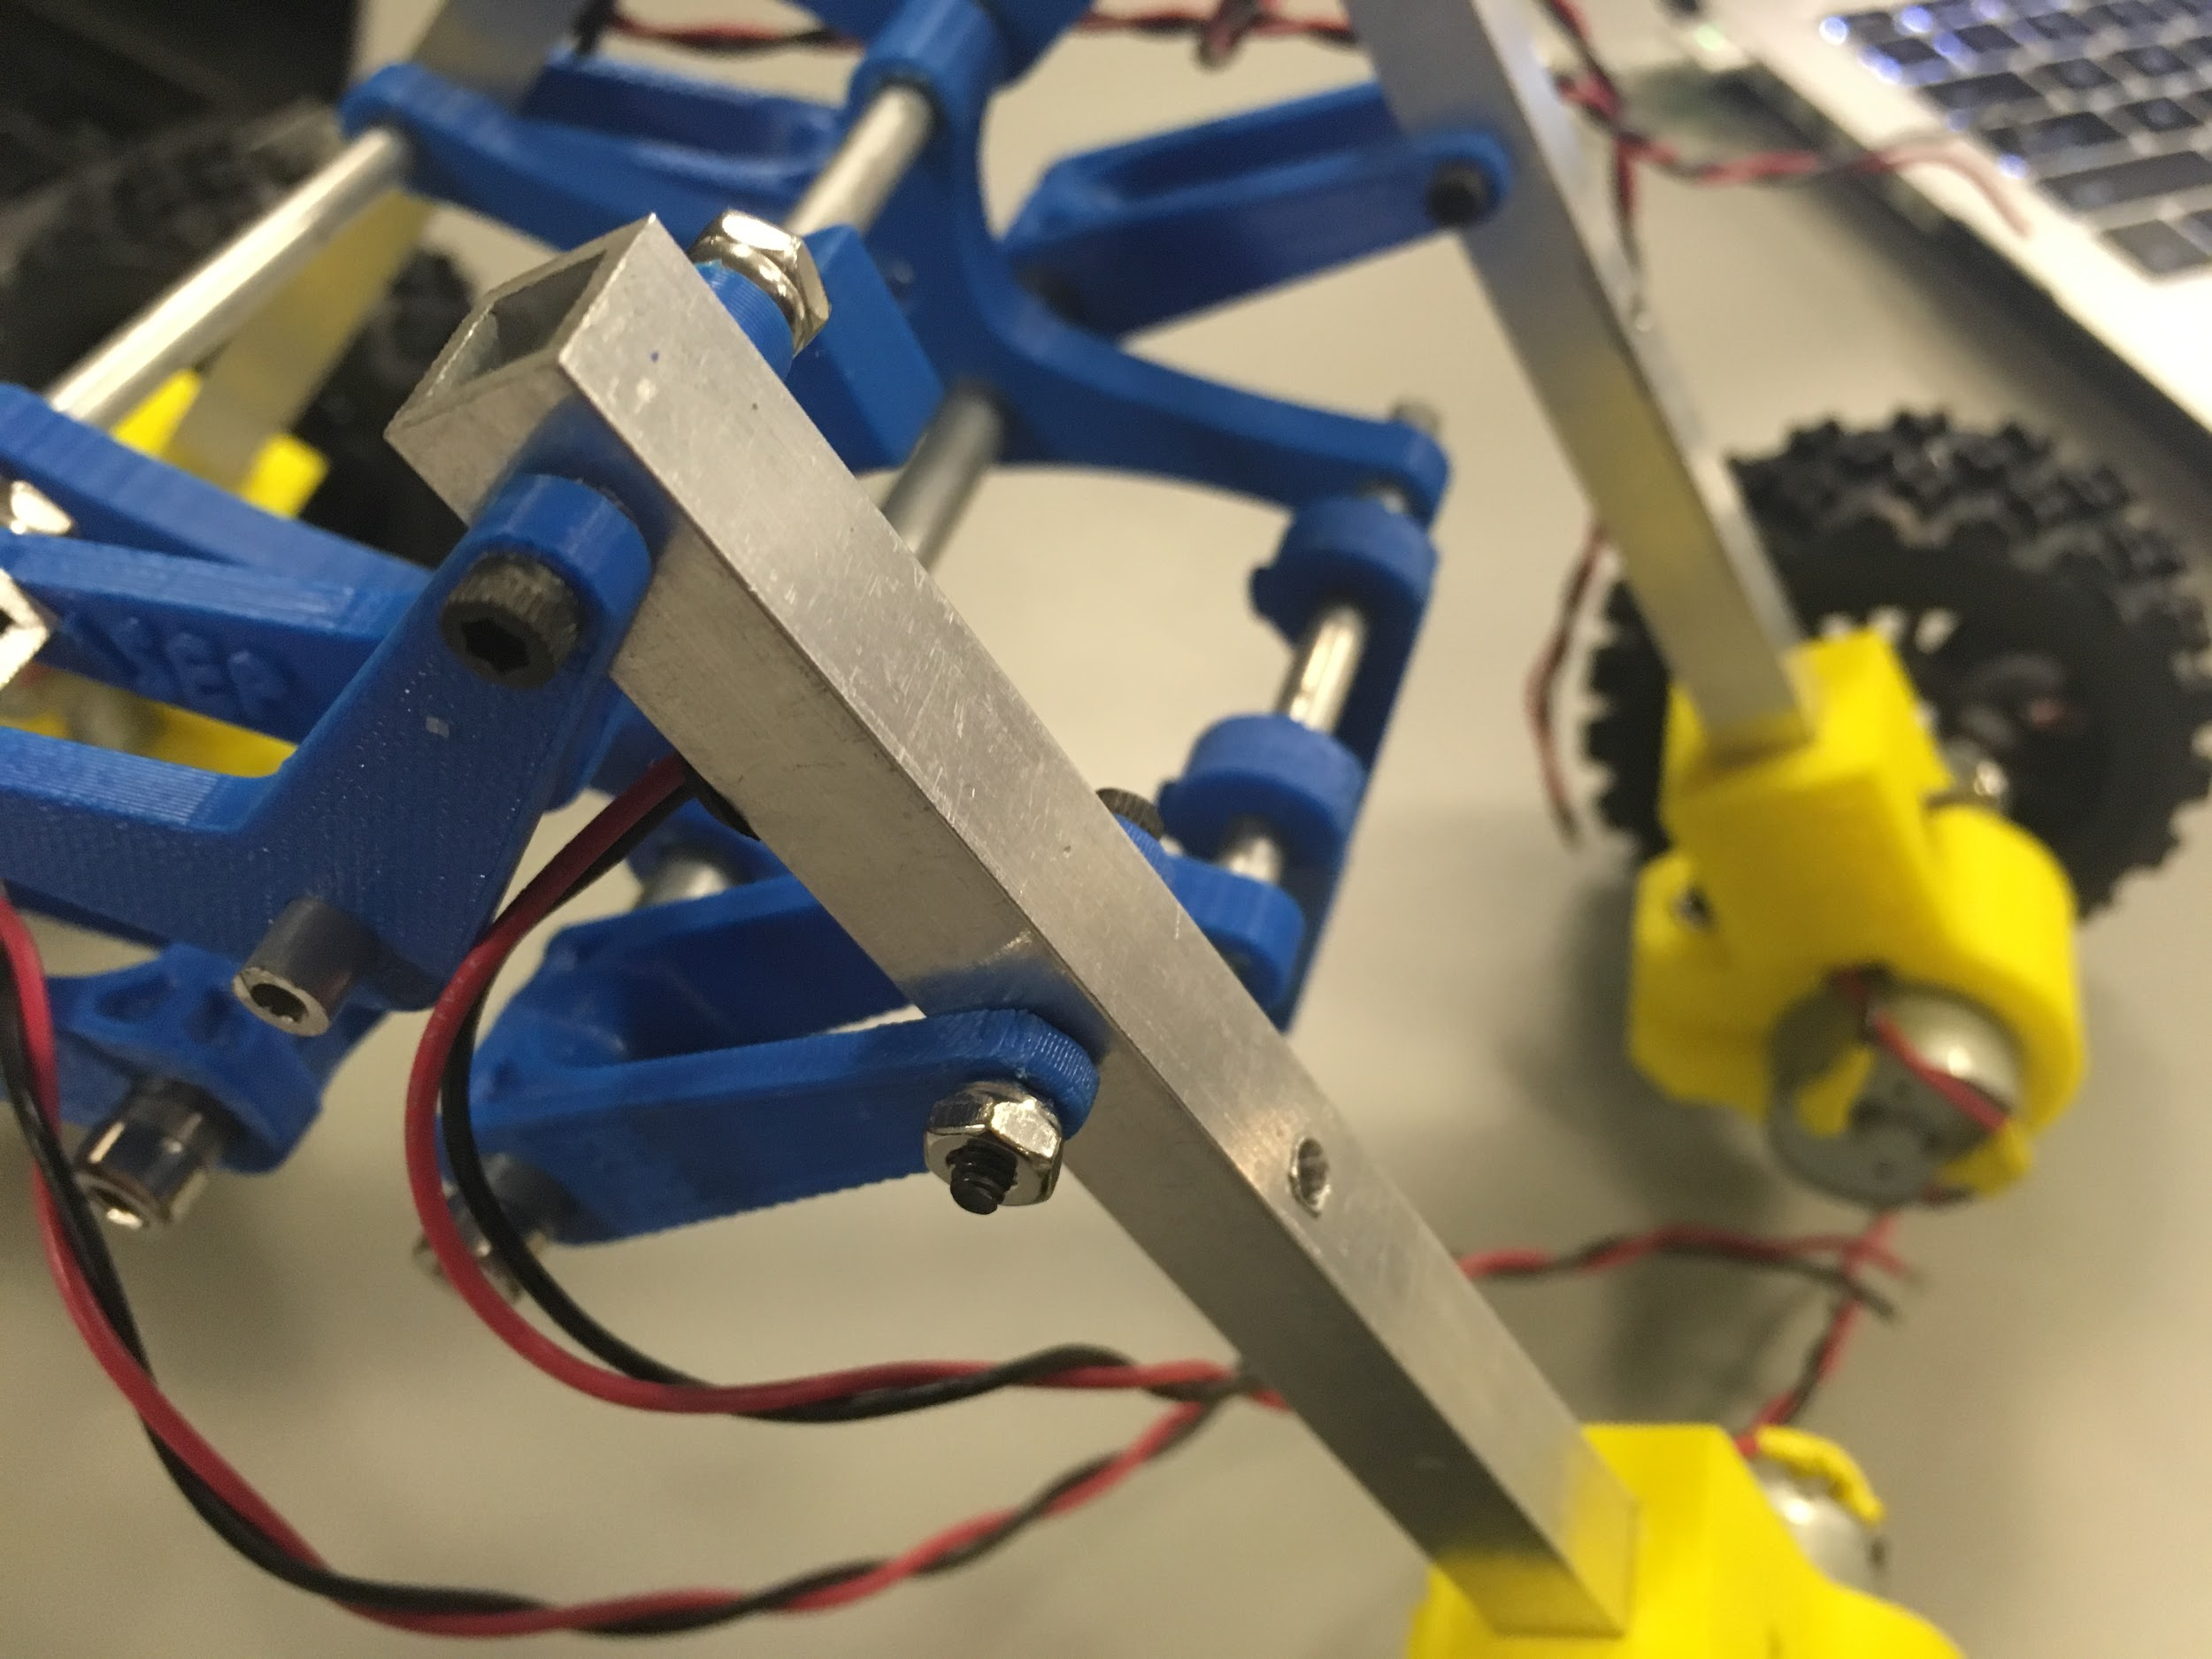
SECURE LEGS TO BODY
← USING ONE INCH HEX BOLT AND LOCKING NUT TO ATTACH LEGS TO BODY
Figure 7

Slide 11
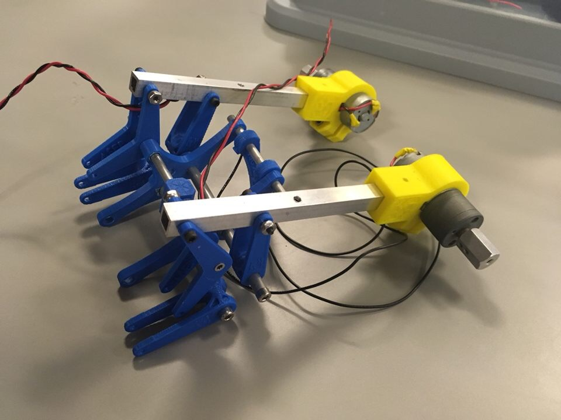
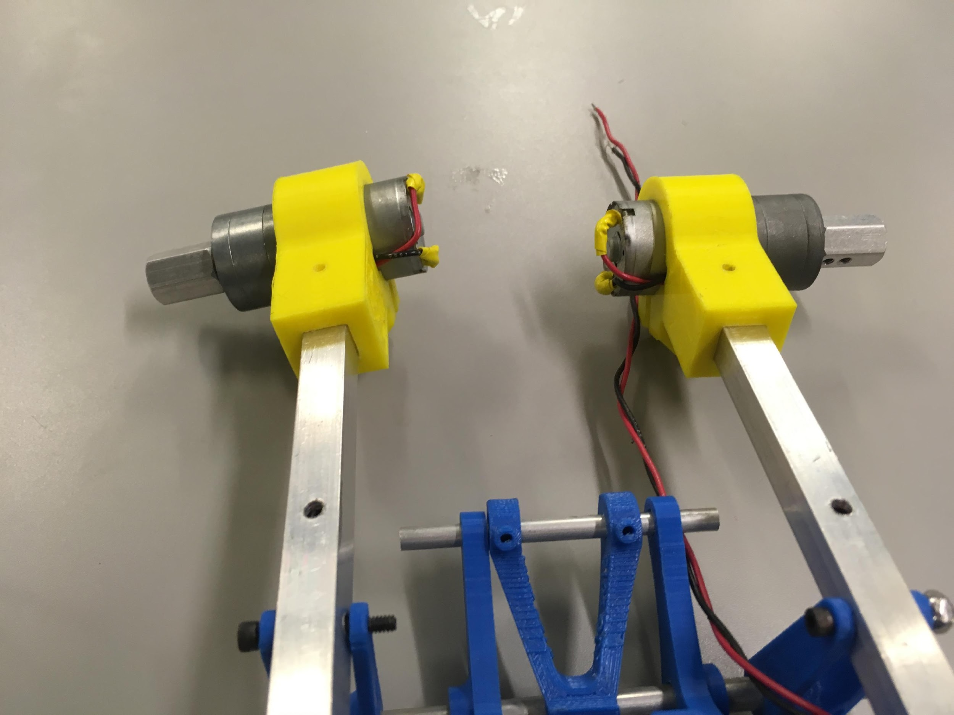
MOTOR ASSEMBLY
Figure 8

Slide 12
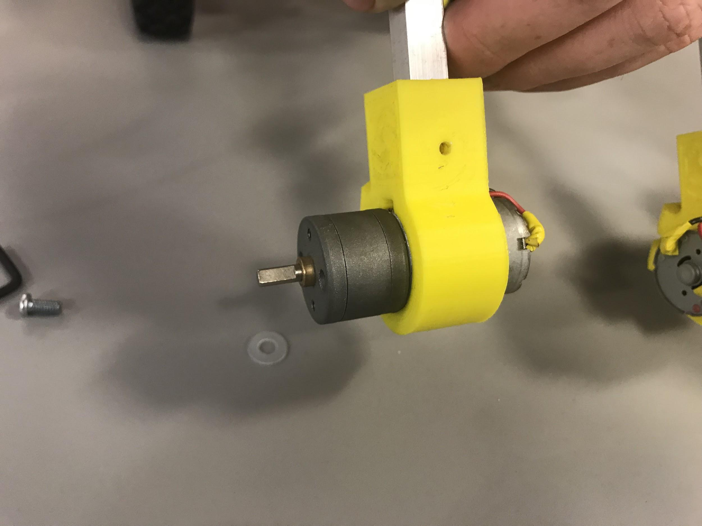
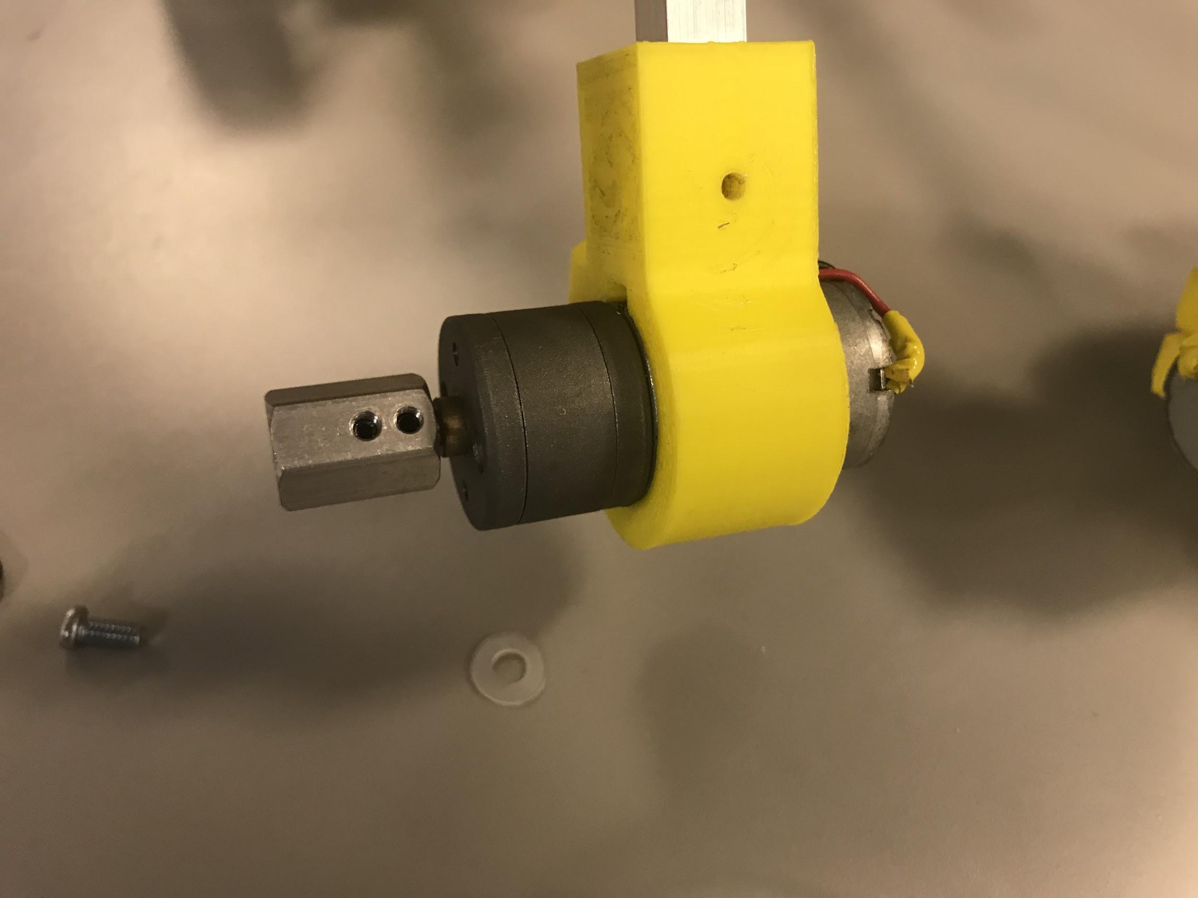
ASSEMBLING WHEELS
Figure 9

Slide 13
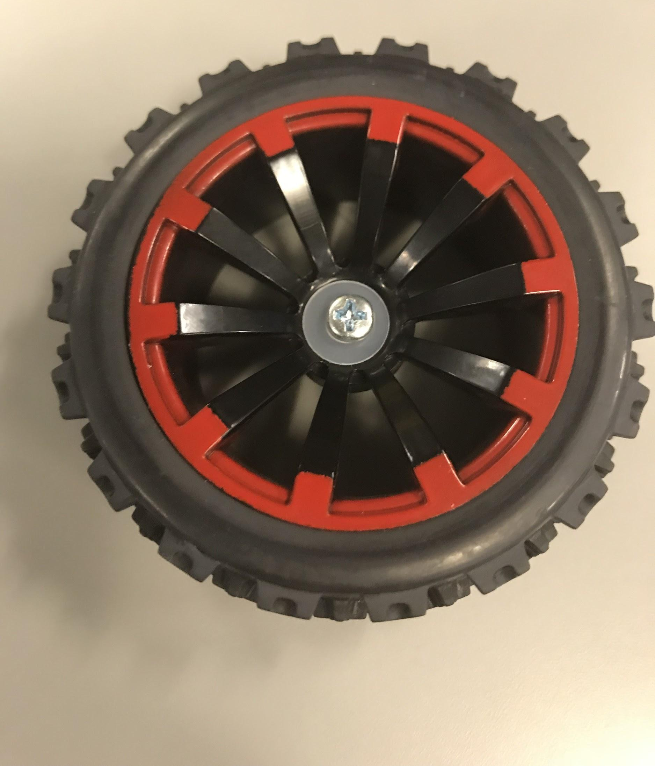
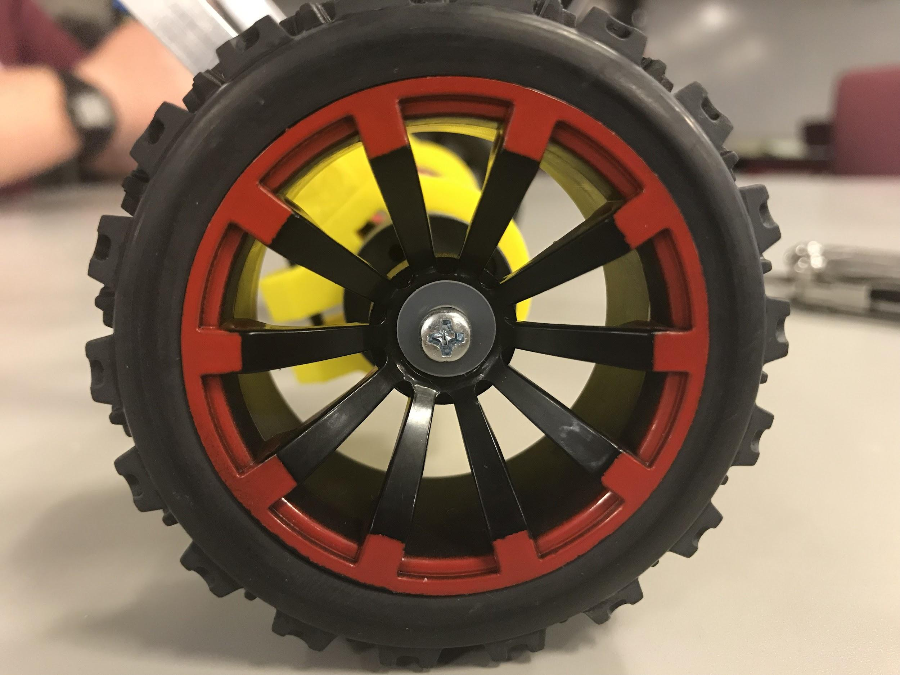
ASSEMBLING WHEELS
Figure 10

Slide 14
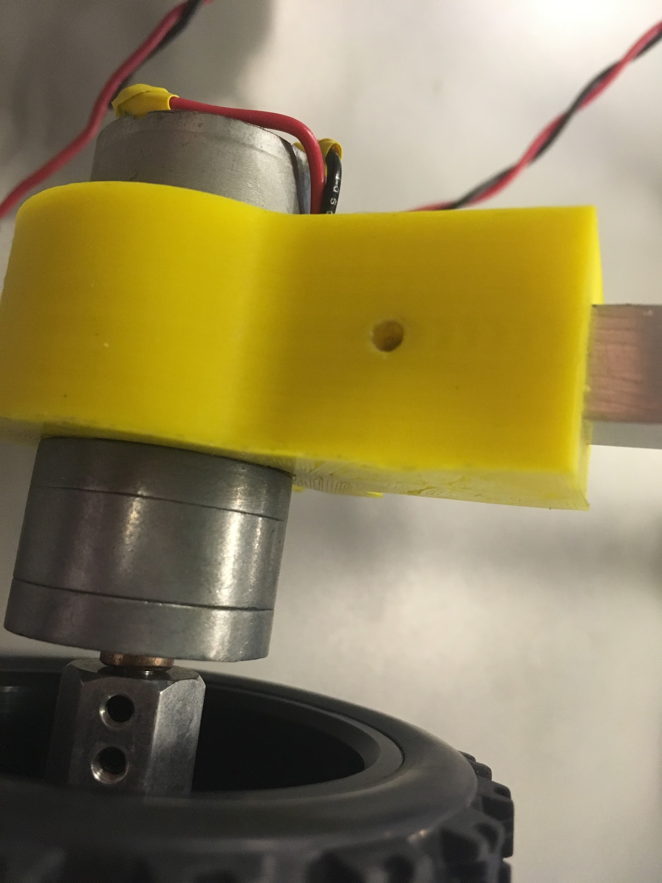
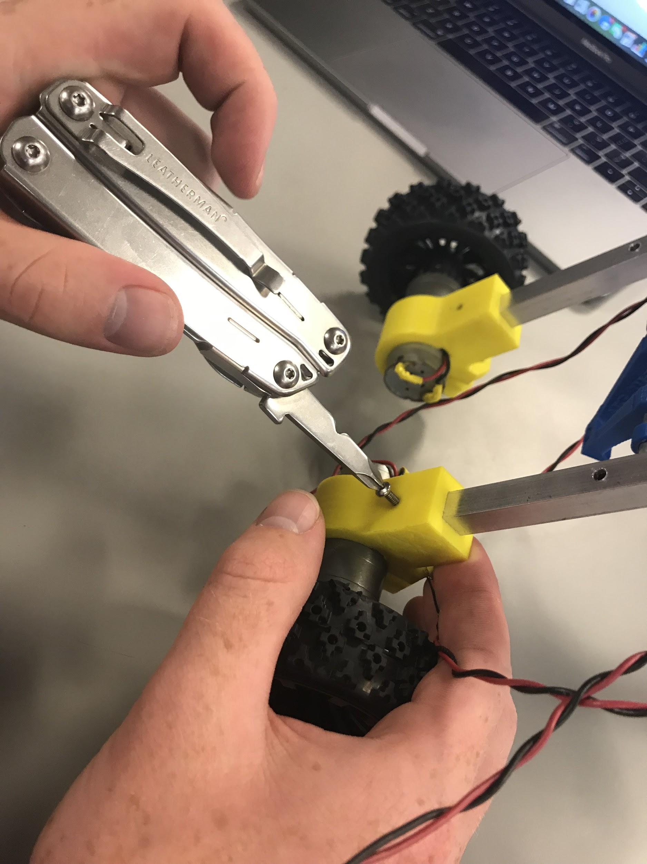
MOTOR ASSEMBLY
← DRILLED HOLE FOR SECURING LEGS TO MOTORS
SECURING →
LEGS TO MOTORS
Figure 11
Figure 12

Slide 15
LESSONS LEARNED
MAKE SURE YOU MARK ALL HOLES THAT NEED TO BE DRILLED
MAKE SURE YOU HAVE THE LEGS THE RIGHT WAY ROUND
MAKE SURE THAT YOU ARE NOT MAKING A ROBOT WITH FOUR LEFT FEET
MAKE SURE YOU ARE NOT PUTTING THE LEFT FOOT ON THE RIGHT SIDE

Slide 16
CONTROL SUB- ASSEMBLY
SOLDIERING
SLED
PICNIC TABLE

Slide 17
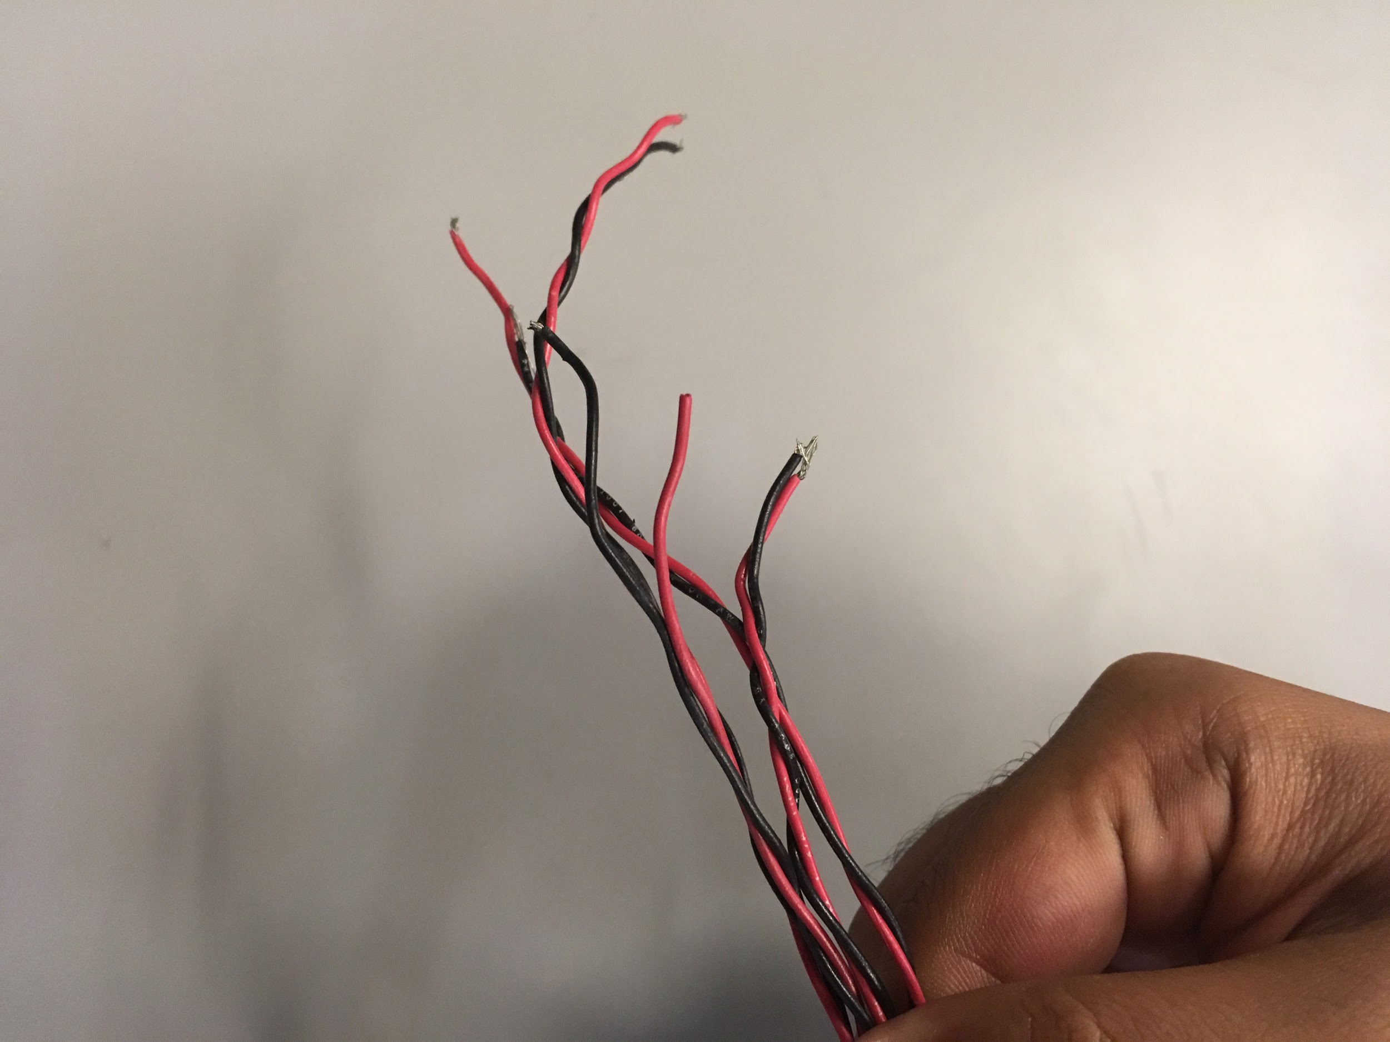
WIRES
← FOUR RED WIRES, FOUR BLACK WIRES, EACH ELEVEN INCHES, STRIPPED, AND A PAIR OF RED AND BLACK WIRES BRAIDED TOGETHER
Figure 13

Slide 18
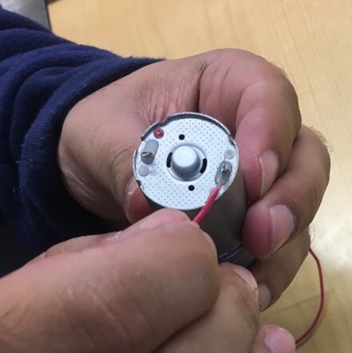
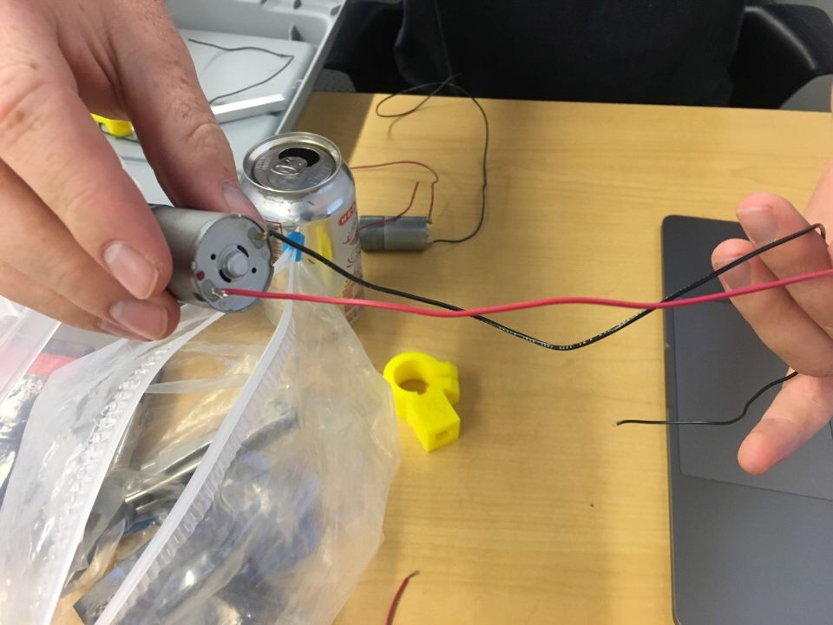
SOLDERING
Figure 14

Slide 19
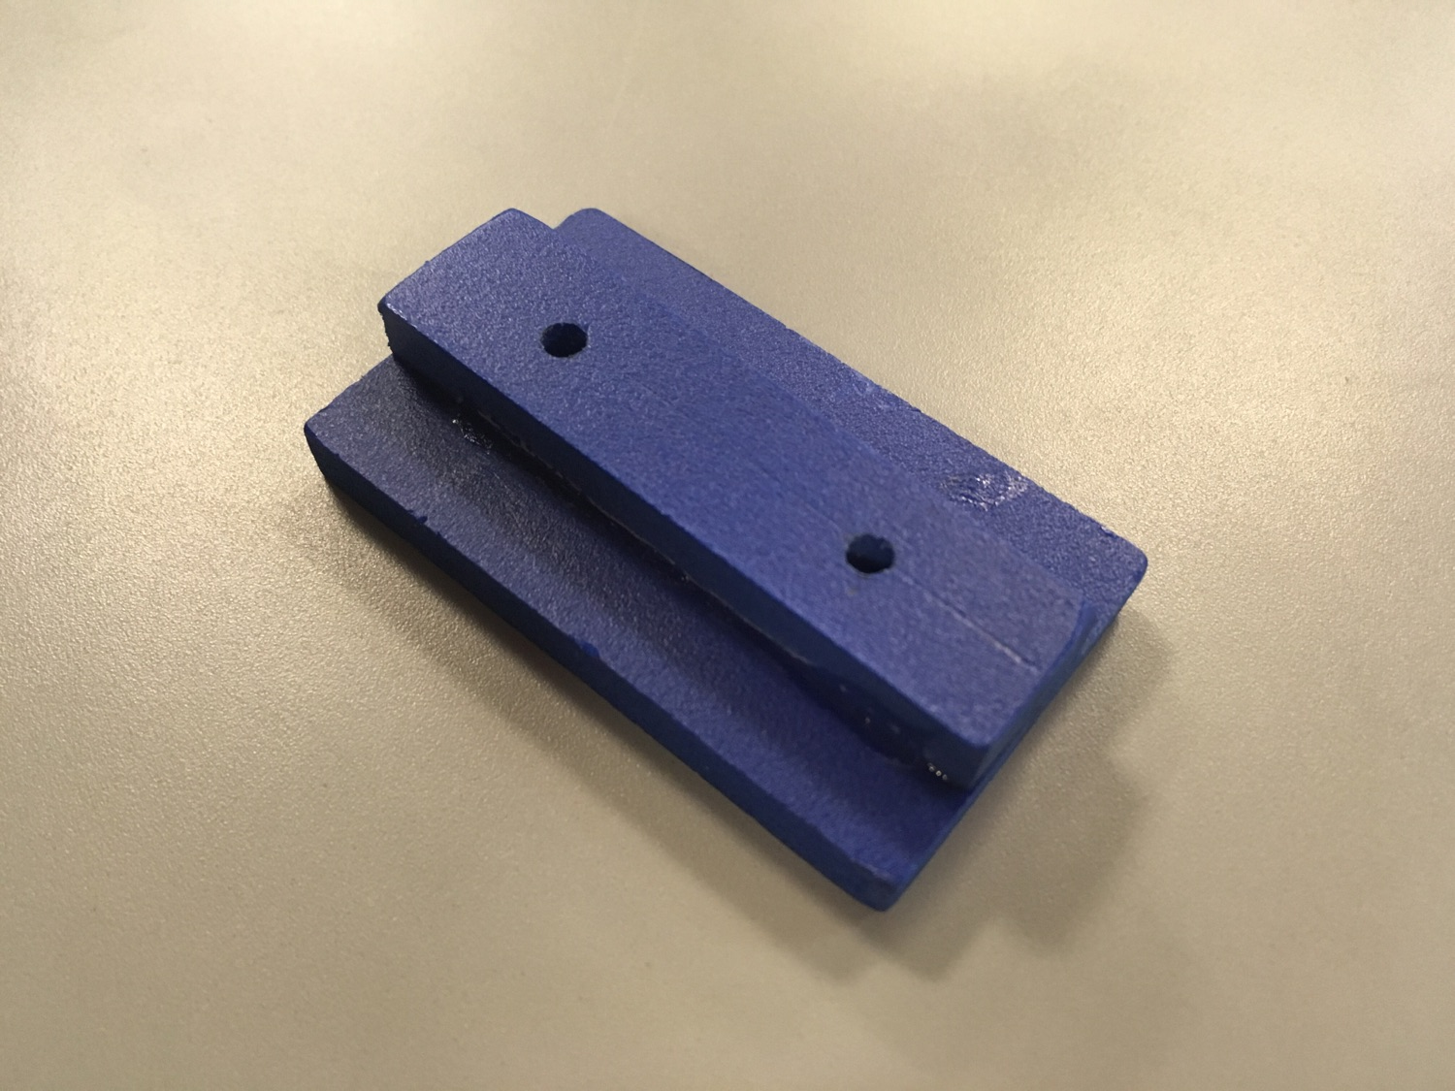
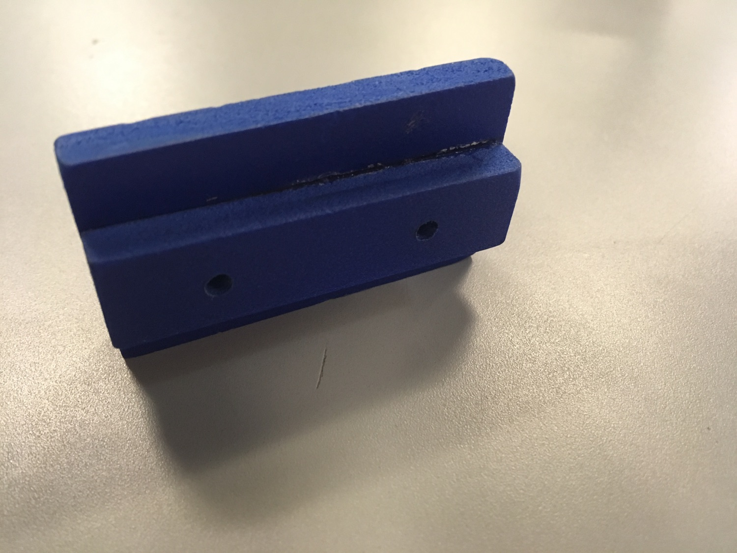
PICNIC TABLE

Slide 20
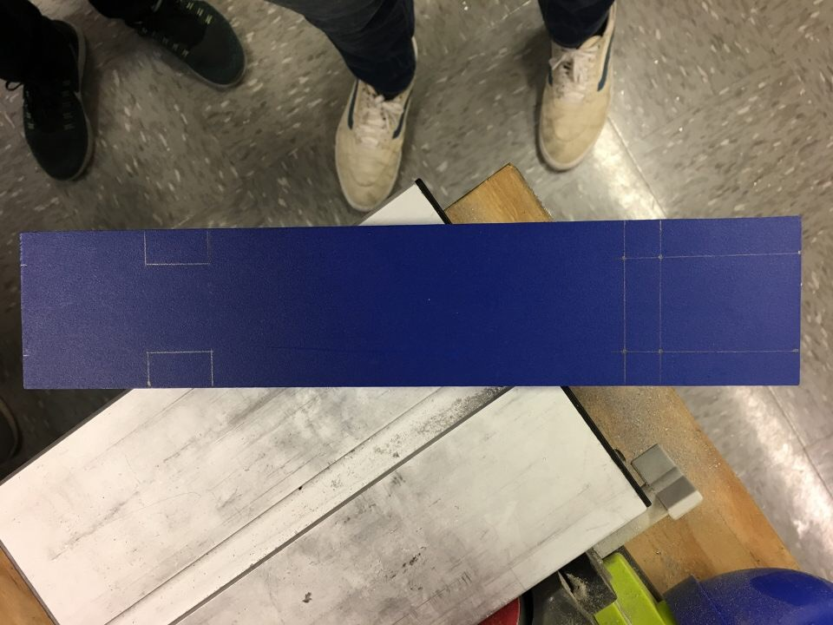
SLED
MARKING MEASUREMENTS FOR DRILLING HOLES AND CUTTING SLED.
Figure 15

Slide 21
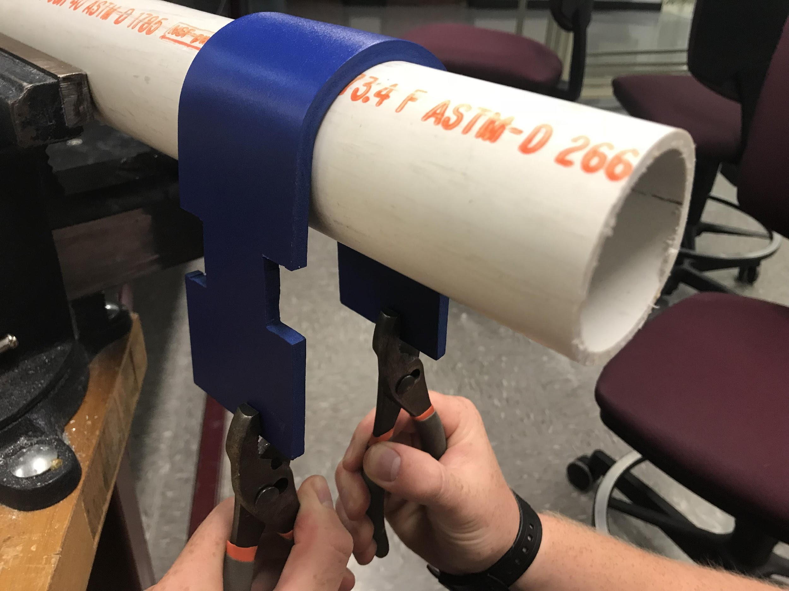
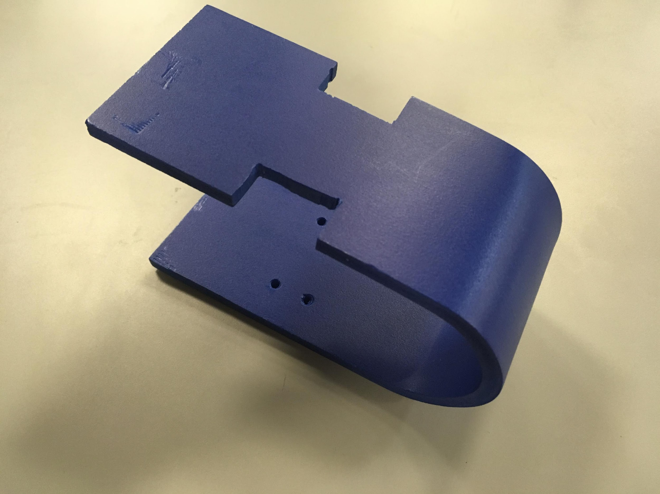
SLED
BENDING SLED INTO PROPER FORM
Figure 16

Slide 22
LESSONS LEARNED
HEAT GUNS ARE HOT
RESOLDERING TAKES MUCH LONGER THAN SOLDERING
MAKE SURE THAT YOU ARE SOLDERING THE RIGHT TERMINALS TOGETHER
MOLTEN SOLDER IS HOT

Slide 23
CONCLUSION
CURRENTLY, OUT DSTR ROBOT IS NEARING COMPLETION OF THE MECHANICAL SUB-ASSEMBLY DESIGN PHASE, BARRING THE ASSEMBLY AND ATTACHMENT OF THE SLED AND LAUNCHPAD. WHAT REMAINS IS FOR OUR DSTR ROBOT TO BE HOOKED UP TO A LAUNCHPAD, AND FOR THE CODE RUNNING THE LAUNCHPAD TO BE DEVELOPED.

